Slide 1
Overview
History, Evolution Of HDL
Typical HDL- based Design Flow
Comparison with Software Programming Languages
Verilog
Register Transfer and Micro Operation
Register Transfer Language
Bus and Memory Transfer
Shift Register
Micro operations (Arithmetic, logic, shift)
Addition, Subtraction
Multiplication Algorithm
Booth Multiplication
CSE 211, Computer Organization and Architecture

Slide 2
History of HDL (Hardware Description Languages)
In the early days, digital circuits were designed using manual schematics and logic gates.
Engineers drew circuits using AND, OR, NOT gates on paper.
As systems became complex (microprocessors, controllers, FPGA designs), manual design became difficult and error-prone.
Designers needed a faster and more reliable way to describe hardware systems.

Slide 3
Evolution of Hardware Description Languages (HDLs)
To simplify digital system design, Hardware Description Languages (HDLs) were introduced.
HDLs allow engineers to describe hardware behavior using code rather than drawing circuits.
Designers can model systems at different levels such as behavioral, dataflow, and structural level.
The two most widely used HDLs are:
VHDL (Very High-Speed Integrated Circuit Hardware Description Language)
Verilog

Slide 4
Typical HDL-Based Design Flow
HDL design follows a systematic process:
Design → Simulation → Synthesis → Verification
Design
- Write HDL code describing the circuit
Simulation
- Test the design using a simulator
Synthesis
- Convert HDL code into hardware gates
Verification
- Ensure the circuit produces correct outputs

Slide 5
HDL Design Flow Using EDA Playground
Steps performed in the simulator:
Write Verilog Design
- Describe the hardware circuit
Create Testbench
- Apply input signals for testing
Run Simulation
- Execute the design using simulator
View Waveform
- Observe signal behavior using EPWave
Verify Output
- Compare results with expected output

Slide 6
Link for simulator
https://www.edaplayground.com/
Sign with google account

Slide 7
Left Window – Testbench (testbench.sv)
This is where you write the testbench code.
A testbench is used to provide inputs and check outputs.
It simulates how the circuit behaves.
Right Window – Design (design.sv)
This is where you write the actual Verilog circuit design.
Example (AND Gate):
Run the Simulation
Steps:
Write design code on the right side.
Write testbench code on the left side.
Click Run (top blue button).
Output will appear in the Log window below.

Slide 8
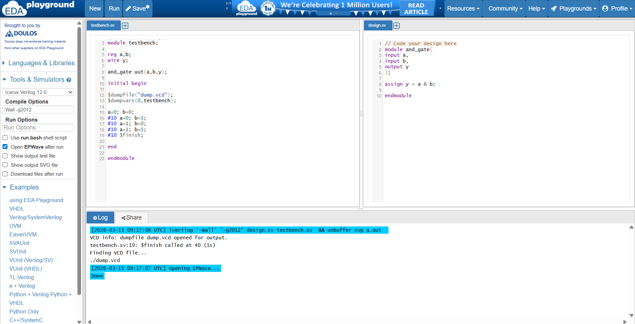

Slide 9
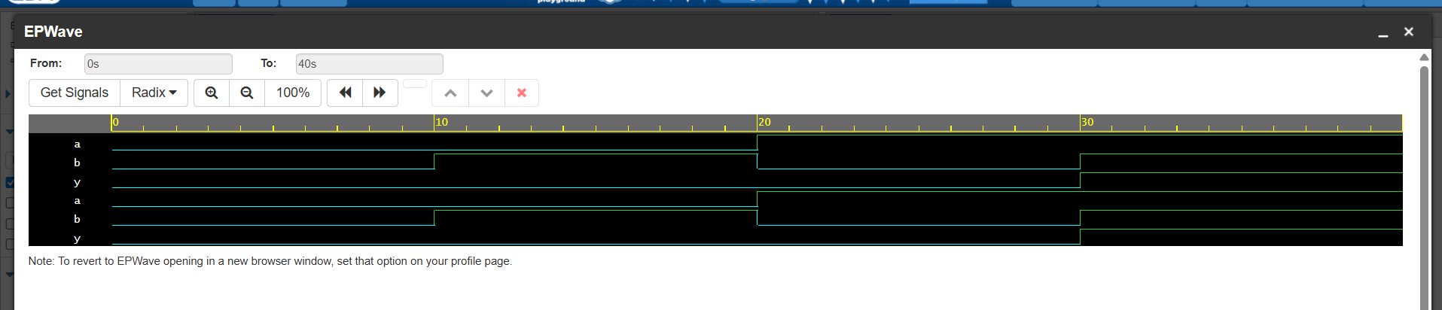
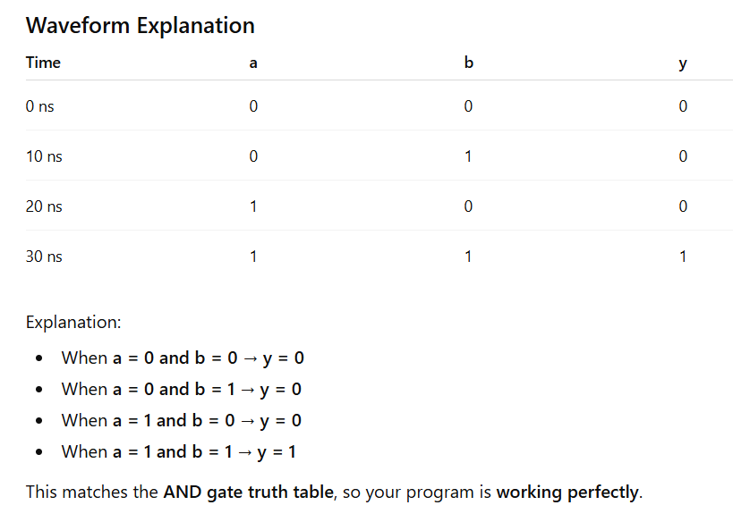

Slide 10
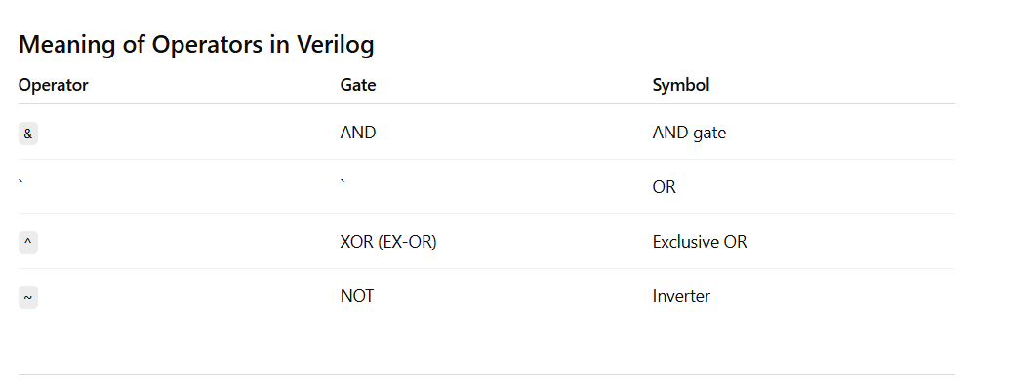

Slide 11
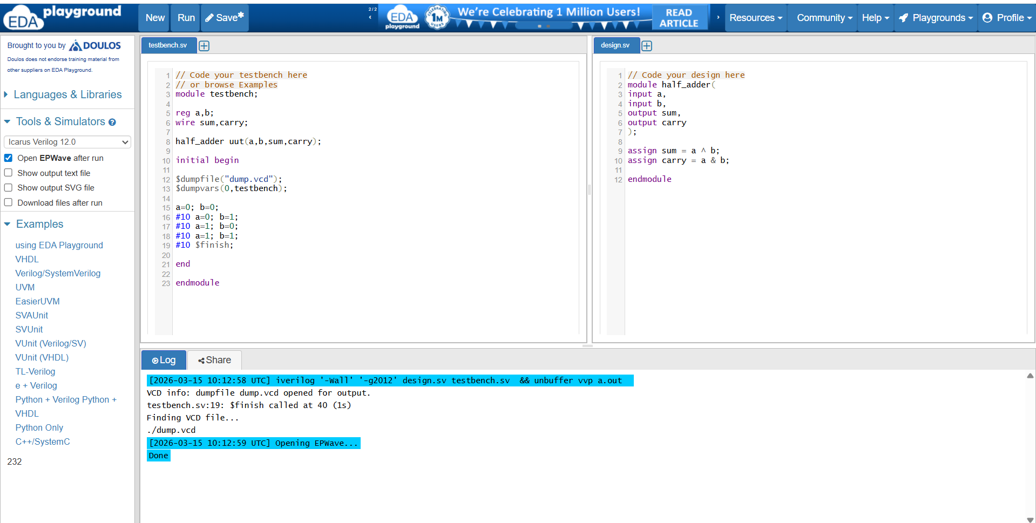
Half Adder
Verilog code

Slide 12
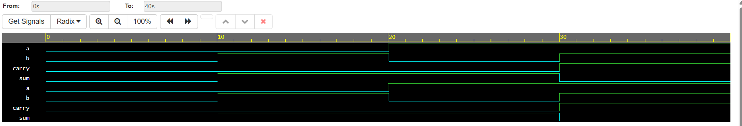

Slide 13
Comparison: HDL vs Software Programming
Feature | Software Programming | HDL
Purpose | Develop software programs | Design hardware circuits
Execution | Sequential | Parallel
Examples | C, Java, Python | Verilog, VHDL
Output | Software application | Digital hardware

